Slide 1

Building a Movie Recommender
By Lean Peria

Slide 2
Goal: Build a Movie Recommender
Prototype: recommender for movie streaming service
Considerations:
Capable of producing a list of recommendations based on a user’s previously liked movies
Should show the best matches first
Should be scalable

Slide 3
Dataset Preparation
We used the MovieLens 20M dataset
Due to memory constraints, we filtered for:
Only movies
Only titles released 2000 onwards
The resulting user-item interaction matrix has:
9,894 movies
77,805 users

Slide 4
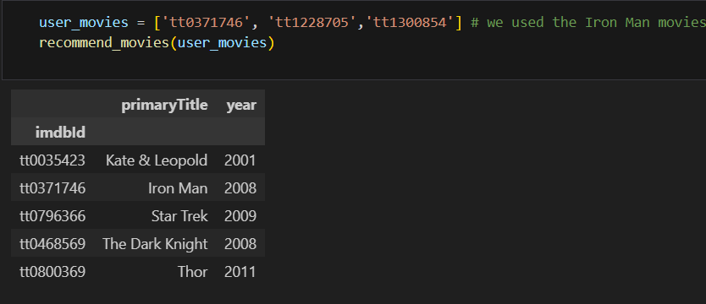
Baseline model
We used K-nearest neighbors for the baseline
We wrote a function that recommends movies given a set of movies that a new user likes (this user is not in the dataset)

Slide 5
Non-negative Matrix Factorization
We used the sklearn implementation of NMF model for building a recommender
Number of latent factors = 50
Matrix initialization – random
Sklearn references:
“Fast local algorithms for large scale nonnegative matrix and tensor factorizations” Cichocki, Andrzej, and P. H. A. N. Anh-Huy. IEICE transactions on fundamentals of electronics, communications and computer sciences 92.3: 708-721, 2009.
“Algorithms for nonnegative matrix factorization with the beta-divergence” Fevotte, C., & Idier, J. (2011). Neural Computation, 23(9).

Slide 6
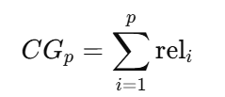
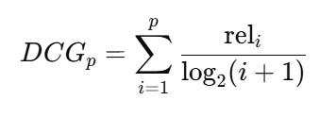
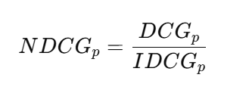
Evaluation metric
We chose the Normalized Discounted Cumulative Gain (NDCG) metric for evaluating the performance of the recommenders
It encapsulates how well the ranked recommendations correspond to the theoretical desired items
For a streaming service, you want to recommend the closest items first!

Slide 7
Model performance
KNN recommender
NDCG@5 = 0.3997
NMF recommender
NDCG@5 = 0.822
A perfect ranking score is 1.
The NMF model performed better!

Slide 8
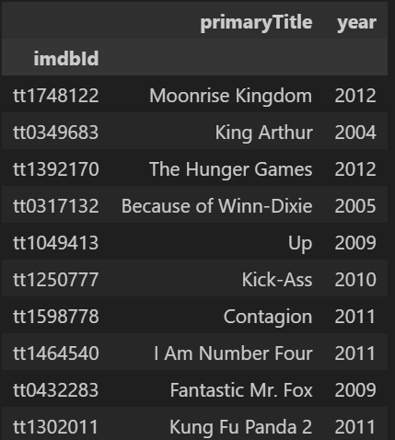
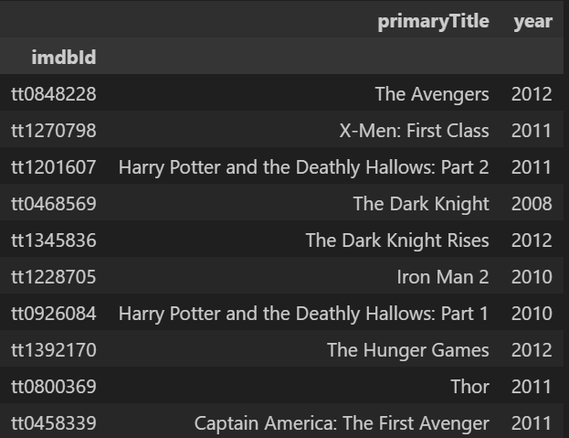
Example recommendations
KNN recommender
NMF recommender

Slide 9
Applying to Streaming Service
The NMF model makes decent recommendations
Points for improvement:
Apply a more scalable solution
Incorporate hybrid methods
Content-based filtering allows for cold starts

Slide 10
Thank you!

